Slide 1
Airplane Satisfaction Analysis
Muhammad Yogi Ilham

Slide 2
Table of Contents
01
Background
02
Analysis
03
Recommendation

Slide 3
01
Background

Slide 4
Understanding the Problem
Situation
Complication
Key Question
Customers has low switching cost due to many competitors and promos.
Maintaining passenger satisfaction is crucial for competitive advantage
There are so many factors involving passengers satisfaction and limited time and resources. Hence, identifying priority is important
What factors are important?
What factors are we good at?
What factors are we terrible at?

Slide 5
Data Understanding
No. | Column | Description | Value
1 | ID | Unique Passenger no | 5 digit unique number
2 | Gender | Passenger sex | Male, Female
3 | Customer Type | Passenger loyalty | Loyal or disloyal
4 | Age | Age | 7-85 y.o
5 | Class | Seat class | Business, Eco Plus, Eco
6 | Flight distance | Length of flight | 56-4983 mi
7 | Inflight wifi service | Satisfaction of wifi service | 1-5
Total 24 columns and 103,904 Rows

Slide 6
Data Understanding
No. | Column | Description | Value
8 | Departure/Arrival time convenient | Satisfaction of schedule time | 1-5
9 | Ease of online booking | Satisfaction of buying ticket online | 1-5
10 | Gate location | Satisfaction of gate location | 1-5
11 | Food and drink | Satisfaction of food and drink quality | 1-5
12 | Online boarding | Satisfaction of online boarding | 1-5
13 | Seat comfort | Satisfaction of seat comfort | 1-5
14 | Inflight entertainment | Satisfaction of entertainment during flights | 1-5
15 | On-board service | Satisfaction of flight attendants | 1-5

Slide 7
Data Understanding
No. | Column | Description | Value
16 | Leg room service | Satisfaction of leg space in their seats | 1-5
17 | Baggage handling | Satisfaction of baggage handling | 1-5
18 | Check –in service | Satisfaction of ease of check in | 1-5
19 | Cleanliness | Satisfaction of plane sanitation | 1-5
20 | Departure Delay in Minutes | Total delayed time of departure | Minutes
21 | Arrival Delay in Minutes | Total delayed time of arrival | Minutes
22 | Satisfaction | Passenger experience | Satisfied, Neutral or dissatisfied
23 | Rating | Average of passengers satisfaction rating | 1-5

Slide 8
02
Analysis

Slide 9
Categorical Analysis

Slide 10
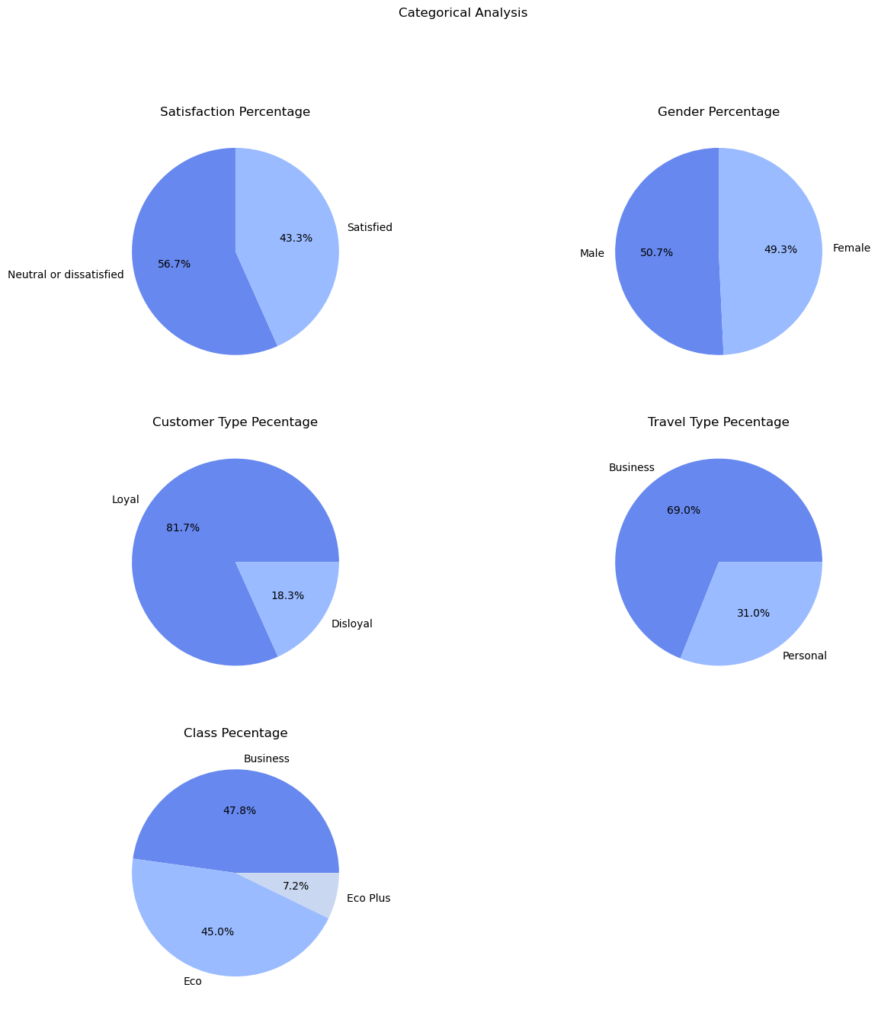
More than half of passengers are dissatisfied
Majority of passengers rated neutral or dissatisfied.
They would be less likely to use our services again

Slide 11
Our company do not have biases towards gender
Passenger’s gender is evenly distributed
Our aircrafts is not biased towards some genders

Slide 12
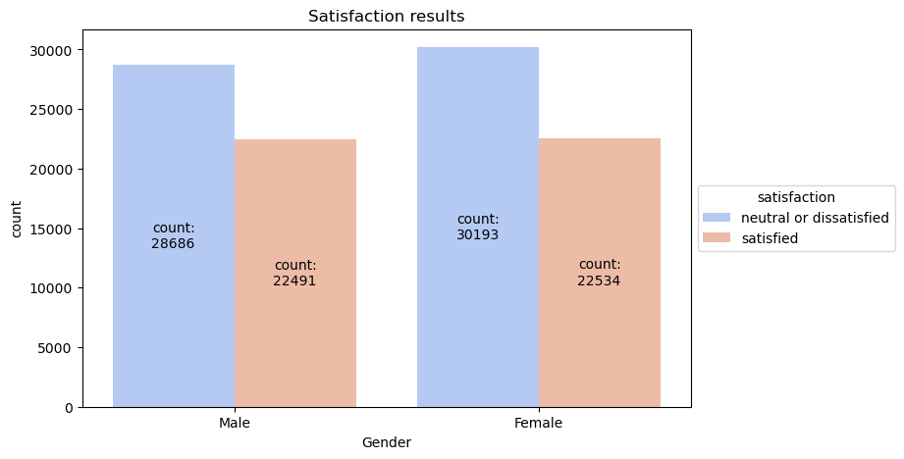
Each gender’s satisfaction is evenly distributed
We do not treat passengers differently based on their genders

Slide 13
Loyal passengers dominated the flight
Around 80% of our passengers are loyal. Which means they use our services more than one time
This could be a symptom that we retain excellent service and opportunity to gain first-time passengers

Slide 14
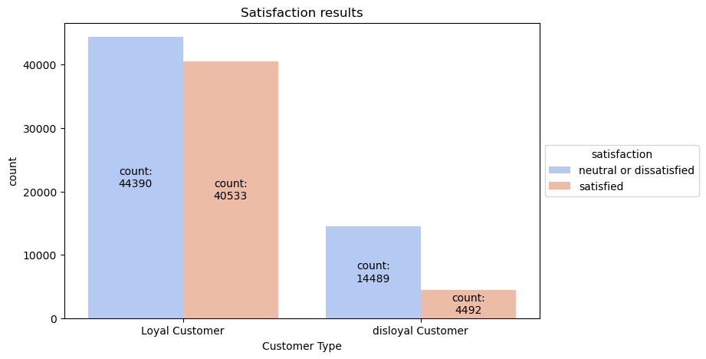
52.5% loyal customers felt neutral or dissatisfied. This may discourage them again to fly again with us
We can offer satisfied disloyal customers loyalty program

Slide 15
Most of our passengers travel due for work
Around two-thirds travel business reasons
Providing business specific needs may be crucial

Slide 16
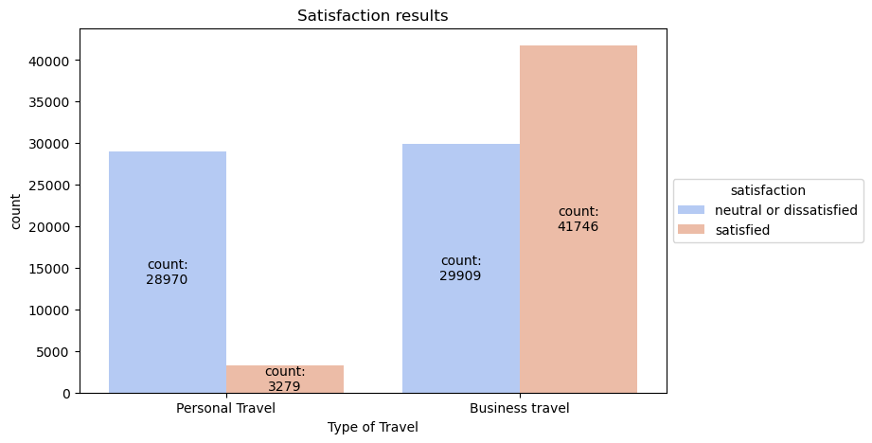
90% of personal travel rated neutral or dissatisfied. Compared to 42% in business travel.
It means there are different treatments between business and personal travel

Slide 17
Only a handful fly eco plus
92.8% of our passengers use Business and Eco class
Further review of Eco Plus is needed to find out why passengers prefer to not choose eco plus

Slide 18
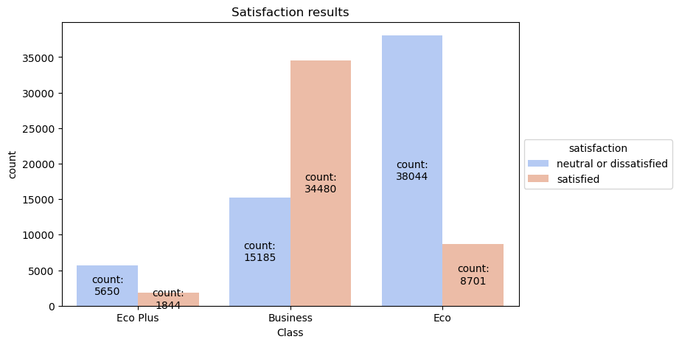
75% Eco Plus and 81% Eco class rated neutral or dissatisfied compared to 30% in Business class
It means we provide different service to each class. Further review of each class treatment is priority to reduce dissatisfaction

Slide 19
Flight Delay Analysis

Slide 20
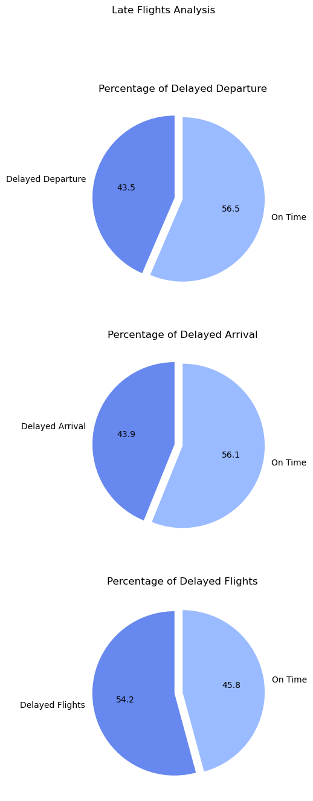
Our flight is not quite reliable yet
the arrival on time percentage has similar figure from departure on time chart. This may mean the biggest cause for delayed arrival is delayed departure.
Only less than half of all flights are on time

Slide 21
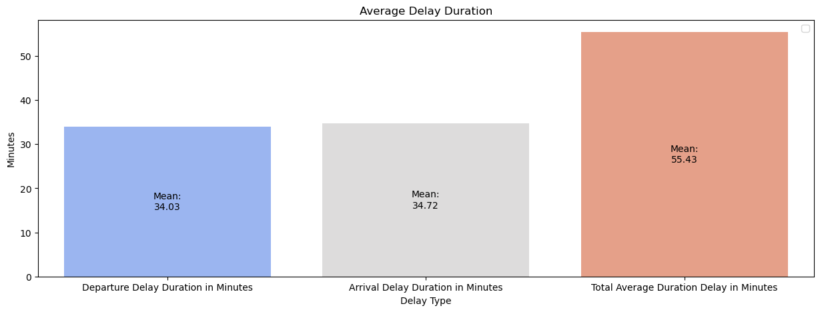
Delays duration on departure and arrival
On average, our flights are 55 minutes longer than expected schedule
Compensations or amenities such as food maybe needed to avoid dissatifaction

Slide 22
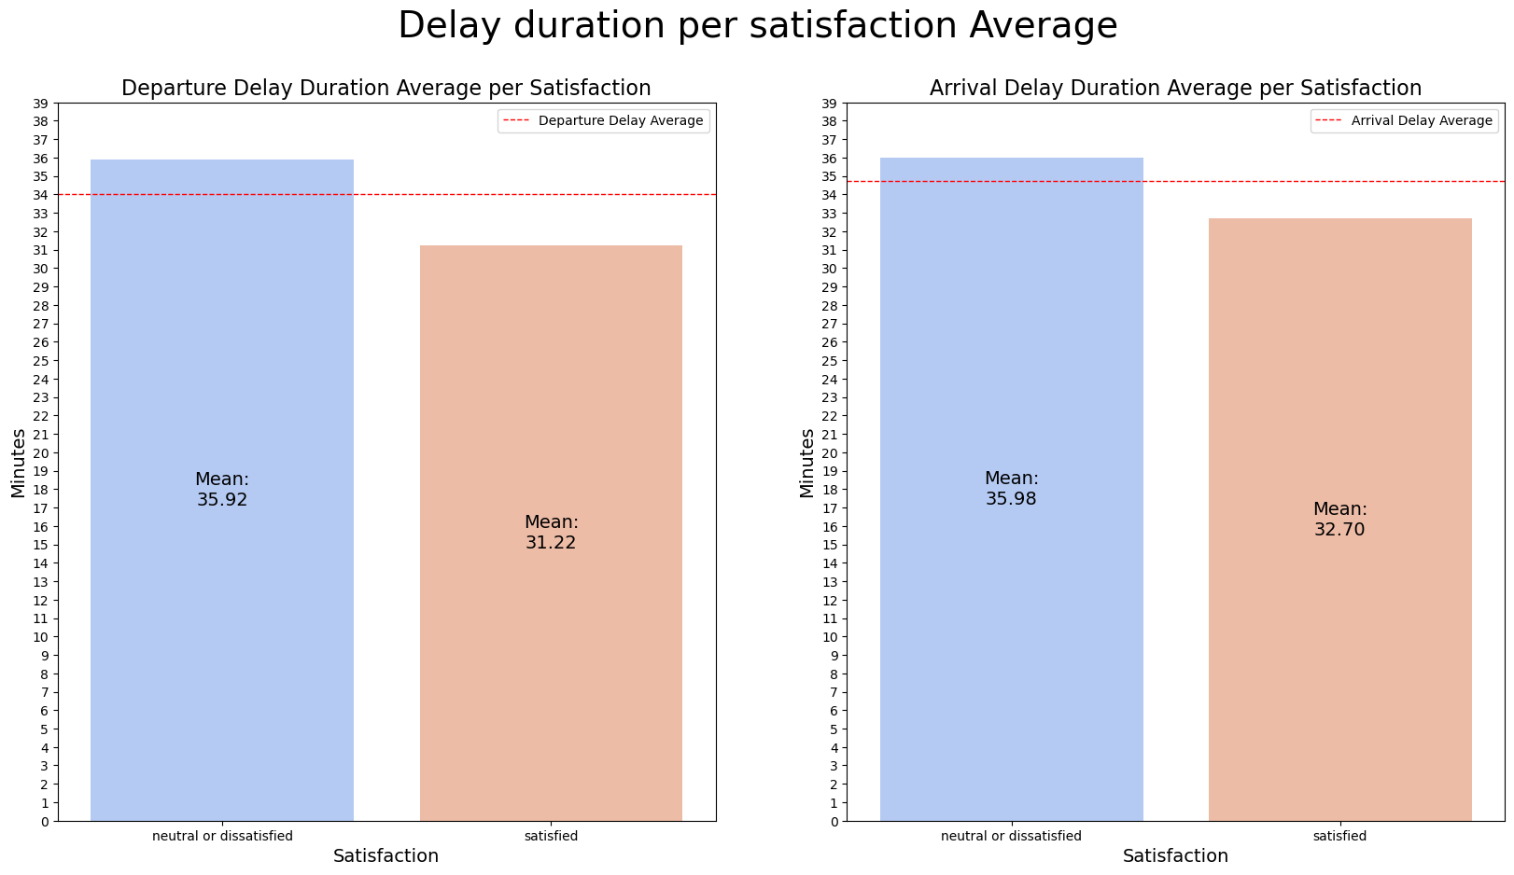
Delay duration by satisfaction
There are significant difference of delay duration in the satisfied and dissatisfied group. Dissatisfied group has longer delay
The US Gov considers a flight to be delayed when it is 15 minutes later than its scheduled time. Averages of our delay violates it.
Significant at a 95% confidence level
Significant at a 95% confidence level

Slide 23
Satisfaction Analysis

Slide 24
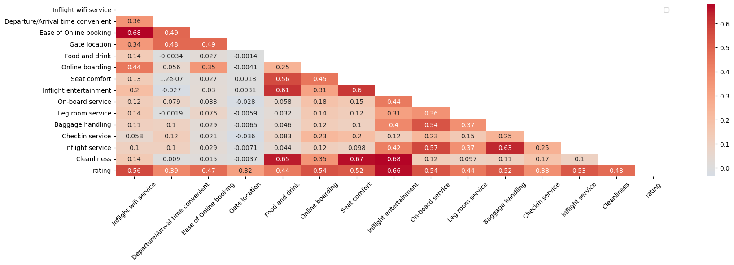
Correlated Factors
Satisfaction is dependent on all of the factors based on Chi-Square Test

Slide 25
Passengers correlation
No. | Variables | Interpretation
1 | Inflight wifi service - ease of online booking | Tech-savvy people would like to stay online all the time
2 | Cleanliness - food and drink | Cleanliness is associated with food hygiene
3 | inflight entertainment - food and drink | Delicious food may cause entertainment more enjoyable
4 | seat comfort - inflight entertainment | Consuming entertainment is better in comfort
5 | seat comfort - cleanliness | Comfortable seat also mean a clean seat
6 | baggage handling - inflight service | Luggage is associated with flight attendant service

Slide 26
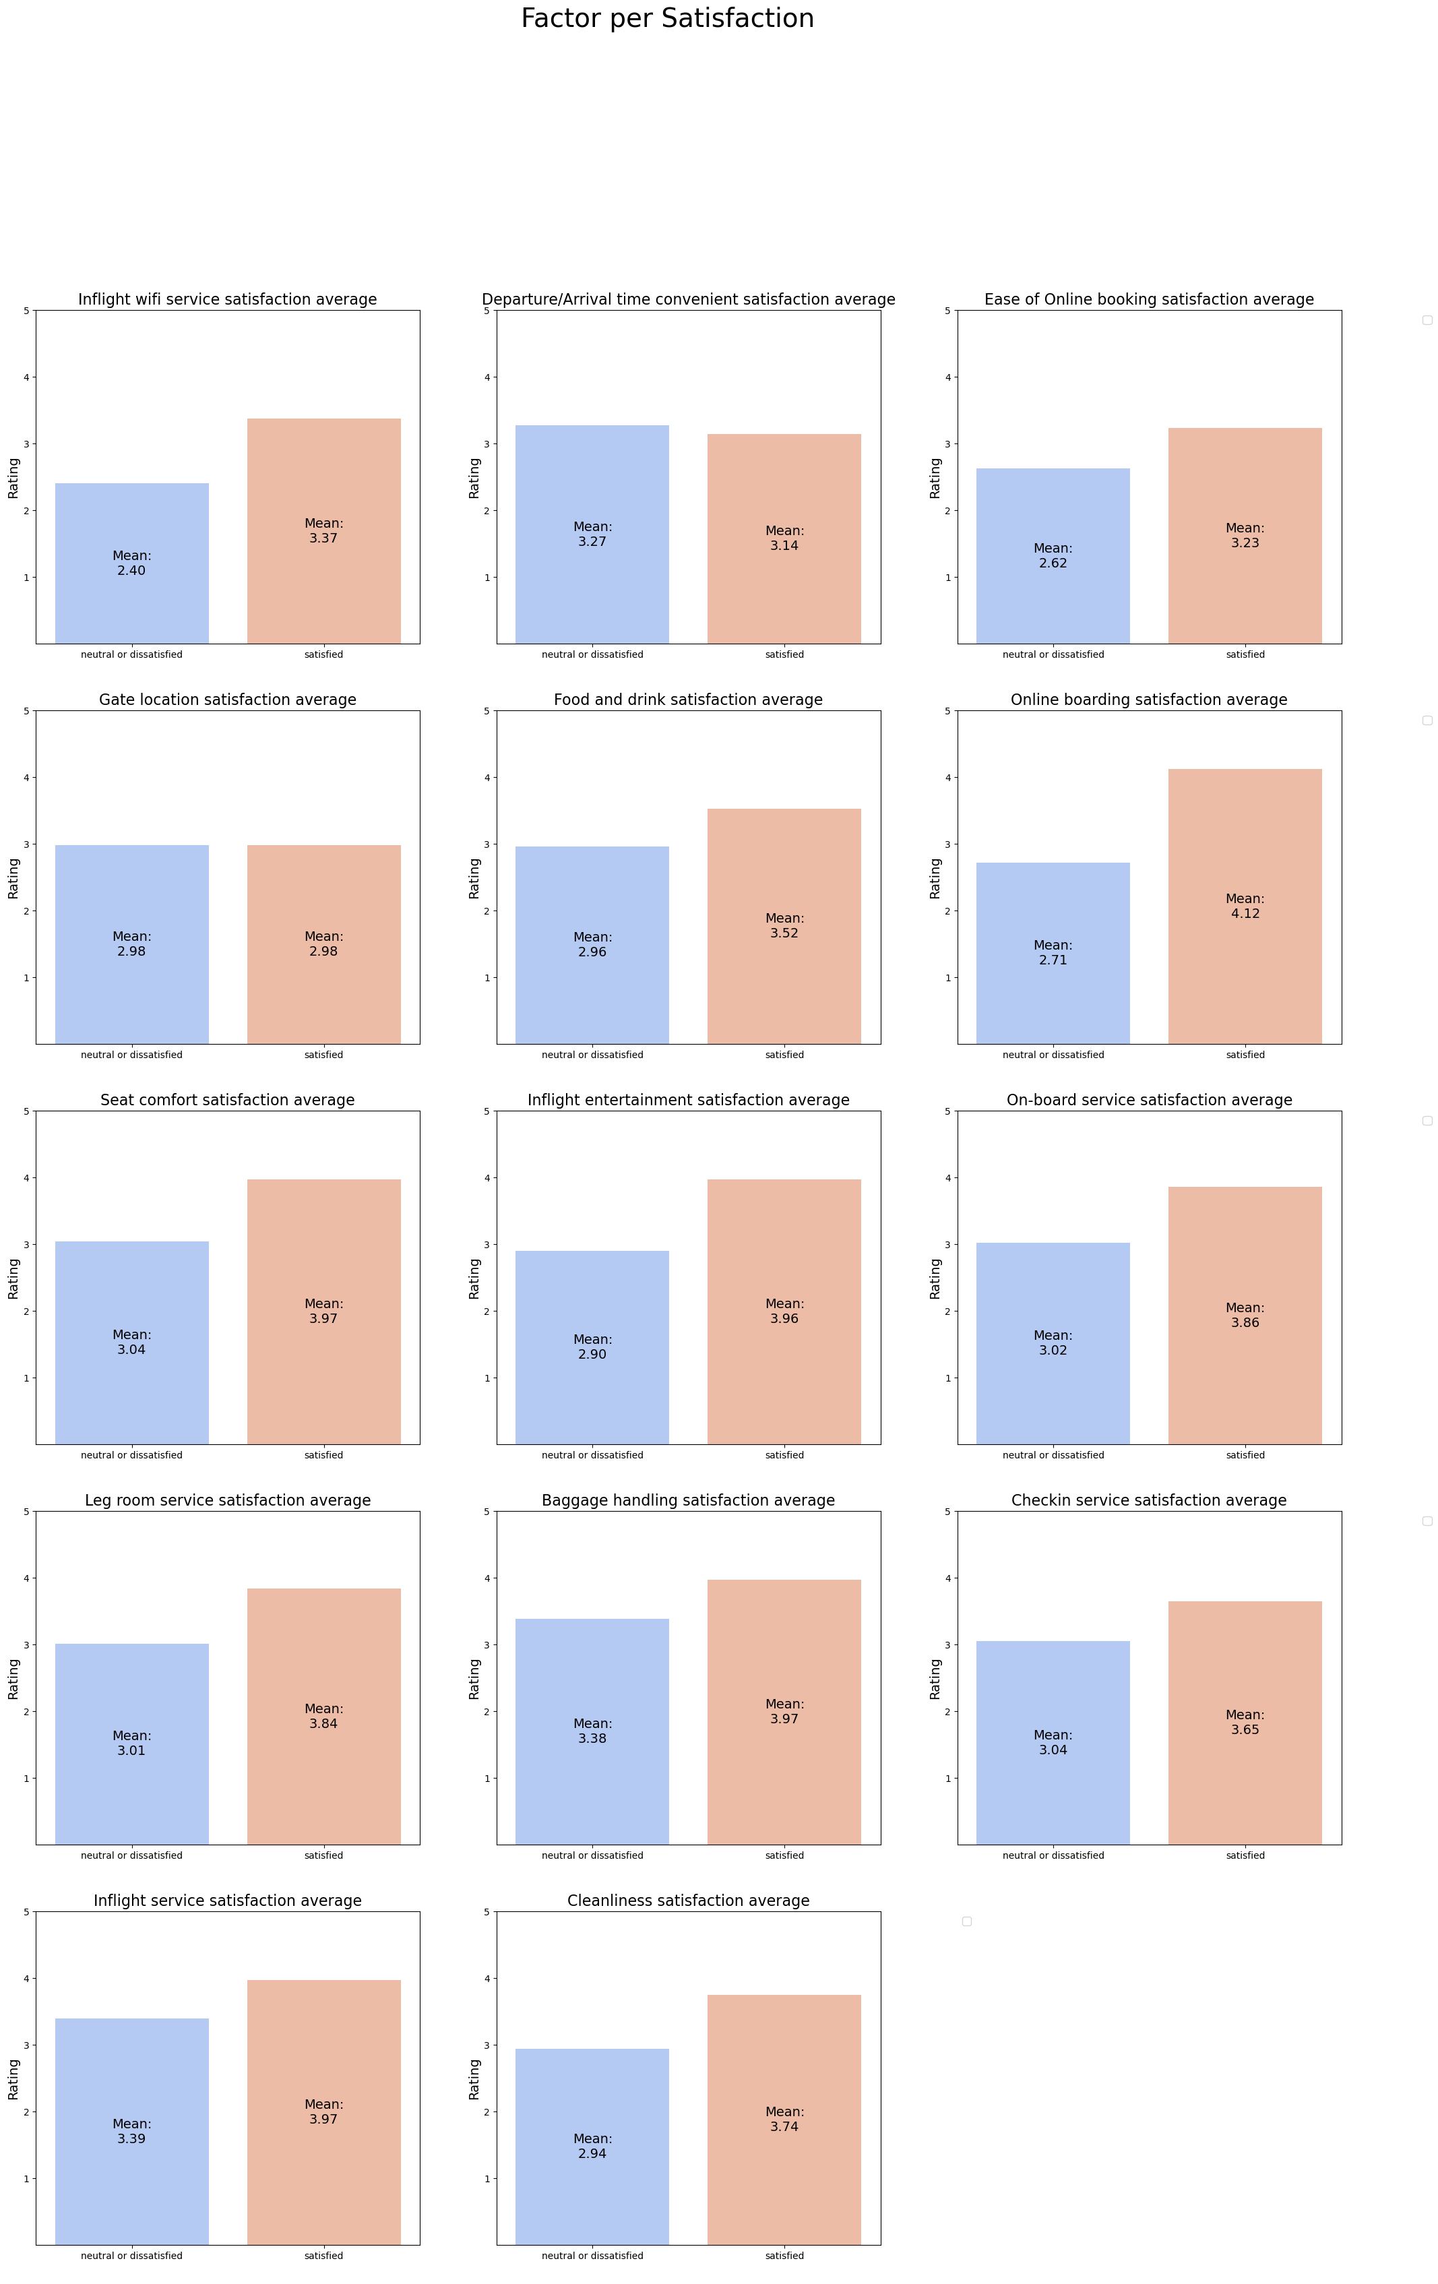
Unequal service is happening
Significant at a 95% confidence level
Significant at a 95% confidence level
Statistically significant difference can be assumed satisfied and dissatisfied passengers received different treatment
There is no significant difference in Departure/Arrival time convenient. We can assume there is no difference between the group
Departure/Arrival time convenient is interesting because dissatisfied passengers rated higher in this factor

Slide 27
Unequal service is happening
Significant at a 95% confidence level
Significant at a 95% confidence level
Statistically significant difference can be assumed satisfied and dissatisfied passengers received different treatment
There is no significant difference in Gate location. We can assume there is no difference between the group

Slide 28
Unequal service is happening
Significant at a 95% confidence level
Significant at a 95% confidence level
Significant at a 95% confidence level
Statistically significant difference can be assumed satisfied and dissatisfied passengers received different treatment

Slide 29
Unequal service is happening
Significant at a 95% confidence level
Significant at a 95% confidence level
Significant at a 95% confidence level
Statistically significant difference can be assumed satisfied and dissatisfied passengers received different treatment

Slide 30
Unequal service is happening
Significant at a 95% confidence level
Significant at a 95% confidence level
Statistically significant difference can be assumed satisfied and dissatisfied passengers received different treatment

Slide 31
Unequal service is happening
the arrival on time percentage has similar figure from departure on time chart. This may mean the biggest cause for delayed arrival is delayed departure.
Only less than half of all flights are on time

Slide 32
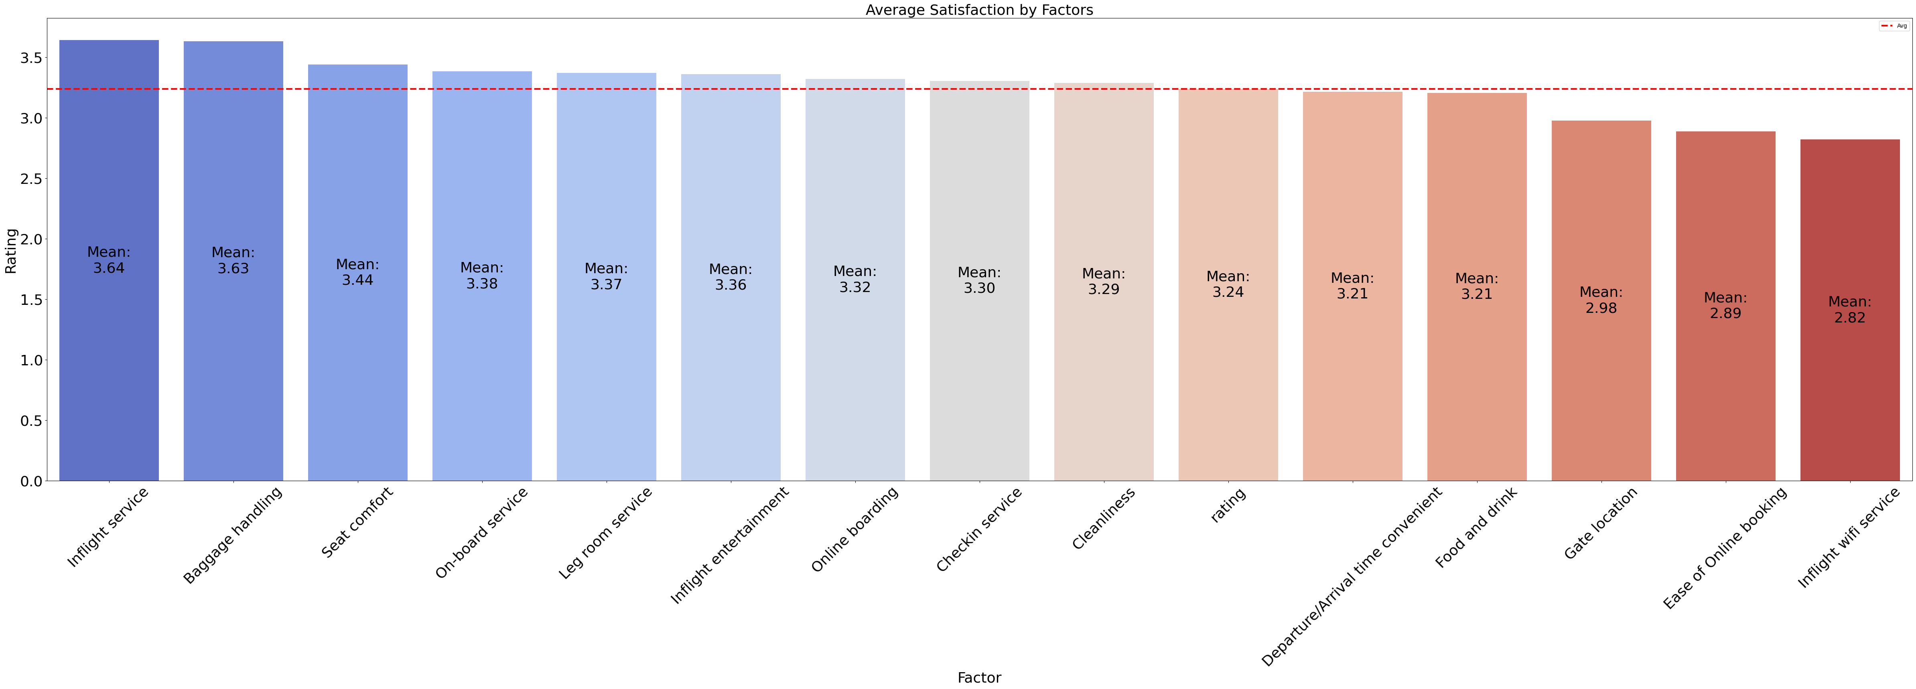
The good, the bad and the average
We provide great on-flight experience as seen consistently with our factors top rating
Passengers had difficulty using wifi and buying tickets online. We need to keep up with technology to maintain our competitive advantage

Slide 33
Conclusion
Categorical
Delay
Satisfaction
Only 43.3% passengers were satisfied
69% of passengers travel due to business reasons
Only 7.2% flew eco plus
Total average delay is 55.4 min
Significant difference in delay durations for satisfied and dissatisfied passengers
Arrival delay is directly affected by departure delay
12 out of 14 factors were found statistically significant different from satisfied and dissatisfied passengers
Our top three services are inflight service, baggage handling and seat comfort

Slide 34
Conclusion
What factors are important for passengers?
What are our strength?
What are our weaknesses?
Satisfaction is depended on all of the factors
Correlation test shows some clues for passengers type
Further causal analysis of passengers segmentation is needed for more info
Excellent on-flight experience
High customers loyalty
Slow to keep up with tech. low rating of online booking and wifi
Delays to half of flights
Unstandardized service to different class, flights and travel reasons

Slide 35
03
Recommendation

Slide 36
Recommendation
Problem
Reco
Output
Terrible Wifi | Prioritize for business class or with extra charge | Faster and manageable wifi
Difficulty buying ticket online | Develop web/app for buying online Connect to travel platform app | Easier to buy ticket online
High number of delays | Develop stricter SOP | Less Delays

Slide 37
Recommendation
Problem
Reco
Output
High disparity of treatment | Develop SOP to standardized service | Equal essential treatment for all passengers
High number of passengers travel due to personal reasons are dissatisfied | Develop specific SOP for these passengers | Higher satisfaction

Slide 38
Impact Effort Matrix
Prioritize for business class or with extra charge
Develop SOP to standardized service
Develop specific SOP for non-business passengers
Connect to travel platform app
Develop app/web for buying ticket online
Develop stricter SOP for delays
Diversification Strategy
High
Impact
Low
Low
High
Effort

Slide 39
Appendix

Slide 40
Chi-Square Analysis
H0: Satisfaction is independent to factor
H1: satisfaction is not independent to factor
No. | Factor | P-value | Interpretation
1 | Inflight Wifi service | 0 | Reject H0
2 | Departure/Arrival time convenient | 2.5+e-91 | Reject H0
3 | Ease of online booking | 0 | Reject H0
4 | Gate location | 0 | Reject H0
5 | Food and drink | 0 | Reject H0
6 | Online boarding | 0 | Reject H0
7 | Seat comfort | 0 | Reject H0

Slide 41
Chi-Square Analysis
H0: Satisfaction is independent to factor
H1: satisfaction is not independent to factor
No. | Factor | P-value | Interpretation
8 | Inflight entertainment | 0 | Reject H0
9 | On-board service | 0 | Reject H0
10 | Leg room service | 0 | Reject H0
11 | Baggage handling | 0 | Reject H0
12 | Check-in service | 0 | Reject H0
13 | Inflight service | 0 | Reject H0
14 | Cleanliness | 0 | Reject H0

Slide 42
Kolmogorov-Smirnov Test for Normality
H0: Data is normally distributed
H1: Data is not normally distributed
No. | Factor | P-value | Interpretation
1 | Inflight Wifi service | 0 | Not Normal Distribution
2 | Departure/Arrival time convenient | 0 | Not Normal Distribution
3 | Ease of online booking | 0 | Not Normal Distribution
4 | Gate location | 0 | Not Normal Distribution
5 | Food and drink | 0 | Not Normal Distribution
6 | Online boarding | 0 | Not Normal Distribution
7 | Seat comfort | 0 | Not Normal Distribution

Slide 43
Kolmogorov-Smirnov Test for Normality
H0: Data is normally distributed
H1: Data is not normally distributed
No. | Factor | P-value | Interpretation
8 | Inflight entertainment | 0 | Not Normal Distribution
9 | On-board service | 0 | Not Normal Distribution
10 | Leg room service | 0 | Not Normal Distribution
11 | Baggage handling | 0 | Not Normal Distribution
12 | Check-in service | 0 | Not Normal Distribution
13 | Inflight service | 0 | Not Normal Distribution
14 | Cleanliness | 0 | Not Normal Distribution

Slide 44
Mann-Whitney Test
H0: mean delay duration dissatisfied group = mean delay duration satisfied group
H1: mean delay duration dissatisfied group != mean delay duration satisfied group
No. | Factor | P-value | Interpretation
1 | Departure Delay Duration (Satisfied - Dissatisfied) | 6.971019169166994e-55 | mean departure delay duration dissatisfied group != mean departure delay duration satisfied group
9 | Arrival Delay Duration (Satisfied - Dissatisfied) | 7.405038456080603e-18. | mean Arrival delay duration dissatisfied group != mean departure delay duration satisfied group

Slide 45
Mann-Whitney Test
H0: mean neutral or dissatisfied passengers = mean factor satisfied passengers
H1: mean neutral or dissatisfeid passengers != mean satisfied passengers
No. | Factor | P-value | Interpretation
1 | Inflight Wifi service (Satisfied - Dissatisfied) | 0 | Significant difference
2 | Departure/Arrival time convenient (Satisfied - Dissatisfied) | 1 | No significant difference
3 | Ease of online booking (Satisfied - Dissatisfied) | 0 | Significant difference
4 | Gate location (Satisfied - Dissatisfied) | 0.5152230299367779 | No significant difference
5 | Food and drink (Satisfied - Dissatisfied) | 0 | Significant difference
6 | Online boarding (Satisfied - Dissatisfied) | 0 | Significant difference
7 | Seat comfort (Satisfied - Dissatisfied) | 0 | Significant difference

Slide 46
Mann-Whitney Test
H0: mean neutral or dissatisfied passengers = mean factor satisfied passengers
H1: mean neutral or dissatisfeid passengers != mean satisfied passengers
No. | Factor | P-value | Interpretation
8 | Inflight entertainment (Satisfied - Dissatisfied) | 0 | Significant difference
9 | On-board service (Satisfied - Dissatisfied) | 0 | Significant difference
10 | Leg room service (Satisfied - Dissatisfied) | 0 | Significant difference
11 | Baggage handling (Satisfied - Dissatisfied) | 0 | Significant difference
12 | Check-in service (Satisfied - Dissatisfied) | 0 | Significant difference
13 | Inflight service (Satisfied - Dissatisfied) | 0 | Significant difference
14 | Cleanliness (Satisfied - Dissatisfied) | 0 | Significant difference

Slide 47
Thank You

